Slide 1
Fueling the Years: Analyzing Price Trends in Euro Super 95, Heating Gas Oil, and Heavy Fuel Oil
Bahador Mirzazadeh
Sadaf Jamali

Slide 2
Introduction
The analysis of energy-related datasets is crucial for understanding market trends, making informed decisions, and developing effective strategies. In this study, we focus on three significant datasets pertaining to energy commodities in Italy: Euro Super 95, Heating Gas Oil, and Heavy Fuel Oil.
Euro Super 95
Euro Super 95 represents a premium-grade gasoline commonly used in automotive applications. Its pricing dynamics are influenced by a myriad of factors, including global crude oil prices, refining costs, distribution expenses, and regulatory changes. By employing time series analysis, we aim to uncover patterns, seasonality, and trends in Euro Super 95 prices, providing insights into the driving forces behind its market fluctuations.

Slide 3
Introduction
Heating Gas Oil
Heating Gas Oil, often utilized in domestic heating systems, is a vital energy source in Italy, particularly during colder months. Understanding the temporal patterns in its pricing is essential for consumers and businesses alike. The application of time series algorithms enables us to model and forecast Heating Gas Oil prices.
Heavy Fuel Oil
Heavy Fuel Oil is a crucial component in various industrial processes and power generation. The pricing of Heavy Fuel Oil is intricately linked to global energy demand, geopolitical events, and regulatory changes. By leveraging time series techniques, we seek to unravel the underlying patterns and drivers of Heavy Fuel Oil prices in Italy.

Slide 4
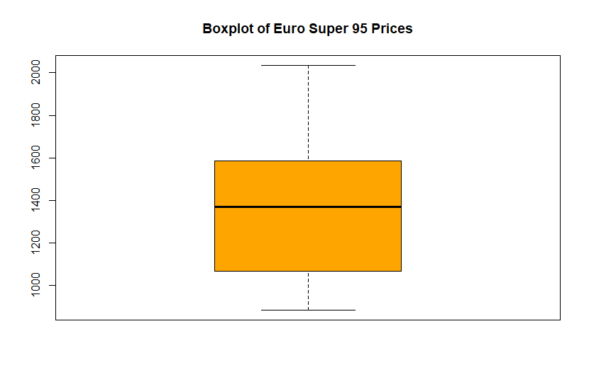
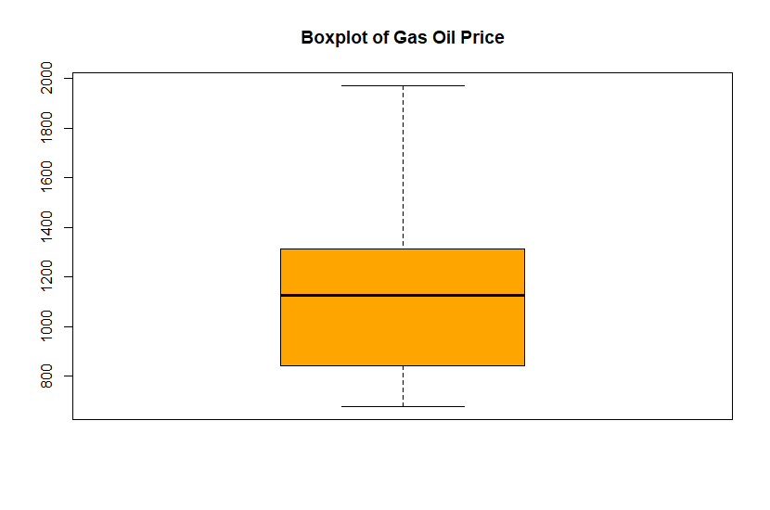
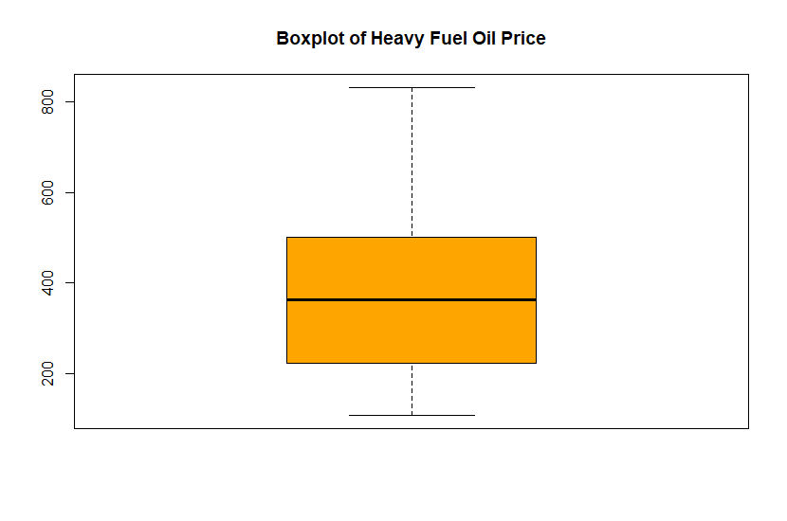
EDA

Slide 5
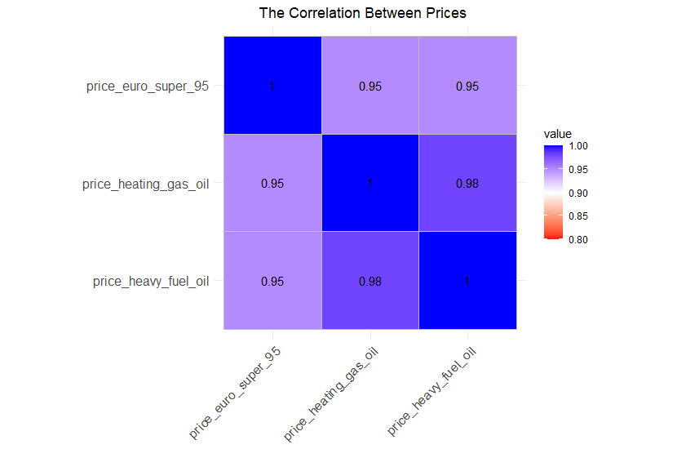
Heatmap

Slide 6
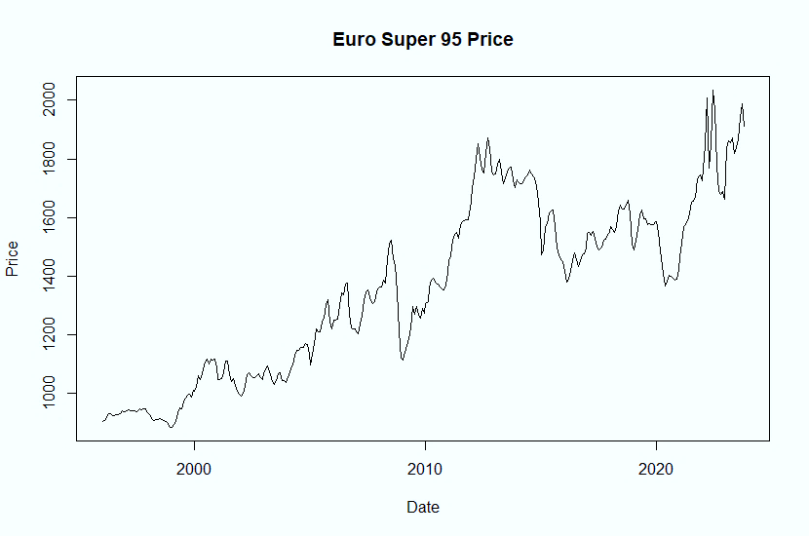

Euro Super 95

Slide 7
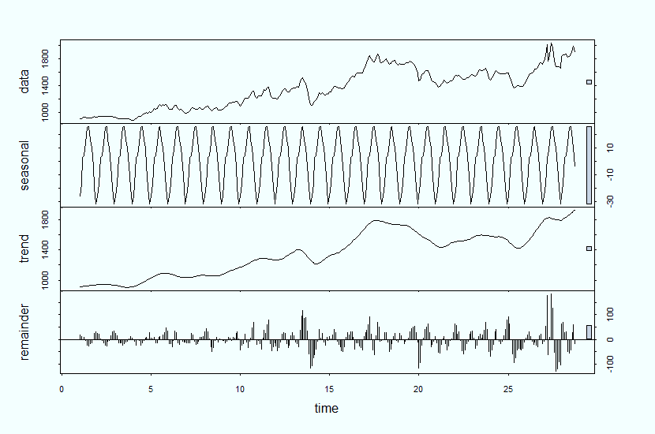

Decomposition of Euro Super 95

Slide 8
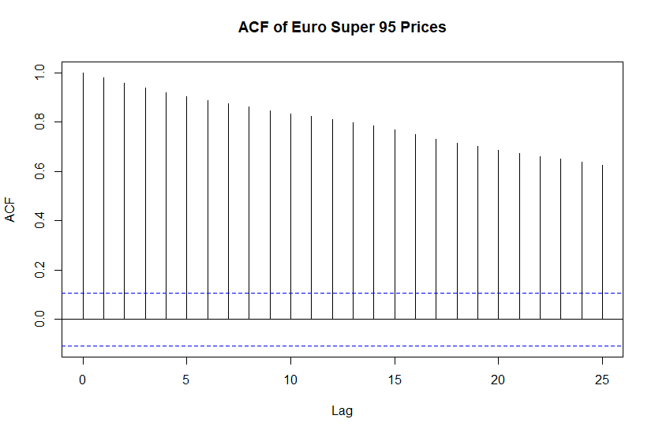
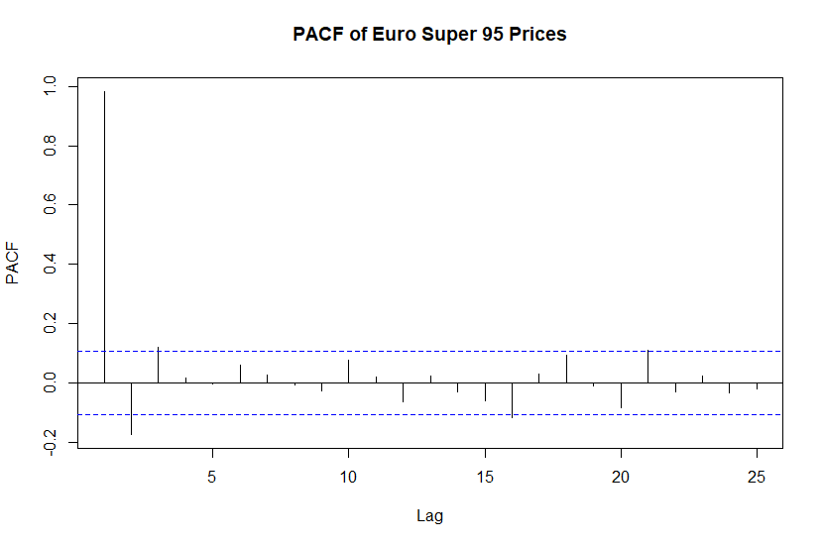
Autocorroelations

Slide 9

Linear Model with Trend and Seasonality
 | Estimate | Std Error | T value | Pr(>|t|)
Intercept | 873.62785 | 28.74873 | 30.388 | <2e-16 ***
trend | 2.73176 | 0.07756 | 35.219 | <2e-16 ***
Season 2 | 9.08288 | 36.51432 | 0.249 | 0.804
Season 3 | 29.65005 | 36.51456 | 0.812 | 0.417
Season 4 | 30.73615 | 36.51498 | 0.842 | 0.401
Season 5 | 40.33153 | 36.51555 | 1.105 | 0.270
Season 6 | 51.14942 | 36.51629 | 1.401 | 0.162
Season 7 | 51.81087 | 36.51720 | 1.419 | 0.157
Season 8 | 42.06304 | 36.51827 | 1.152 | 0.250
Season 9 | 36.70592 | 36.51951 | 1.005 | 0.316
Season 10 | 24.14452 | 36.52091 | 0.661 | 0.509
Season 11 | 4.91091 | 36.85208 | 0.133 | 0.894
Season 12 | -6.97937 | 36.85282 | -0.189 | 0.850

Slide 10
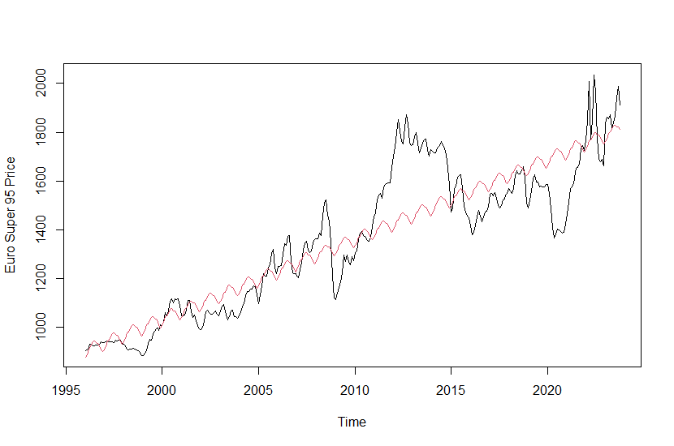
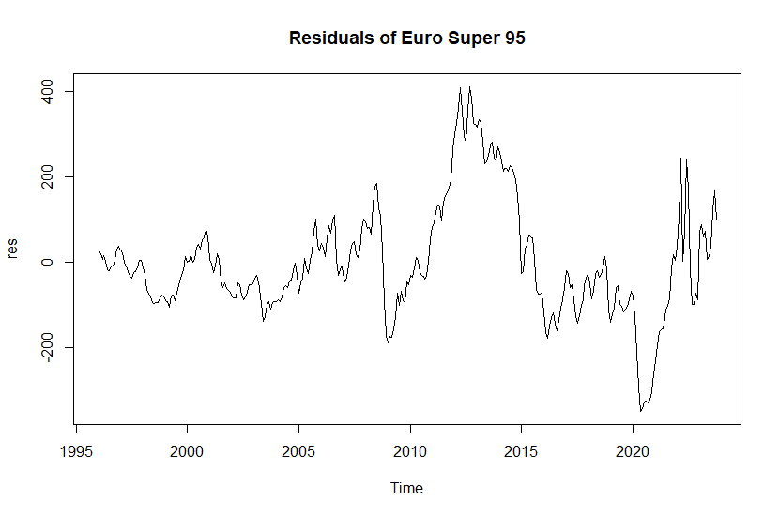
TSLM for Euro Super 95
DW : 0.080474
R-squared: 0.7957

Slide 11
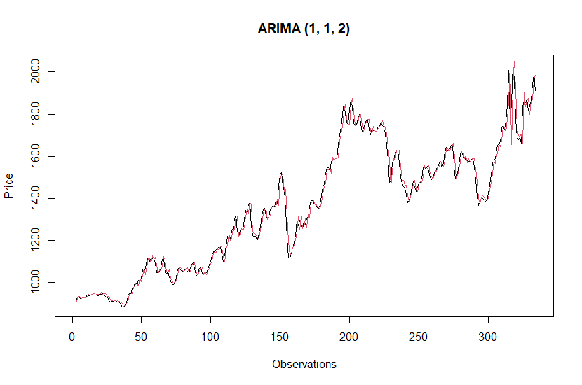

AUTO ARIMA

Slide 12

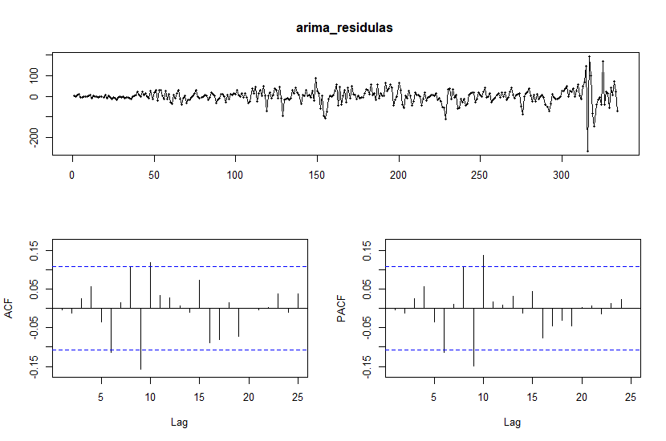
AUTO ARIMA

Slide 13

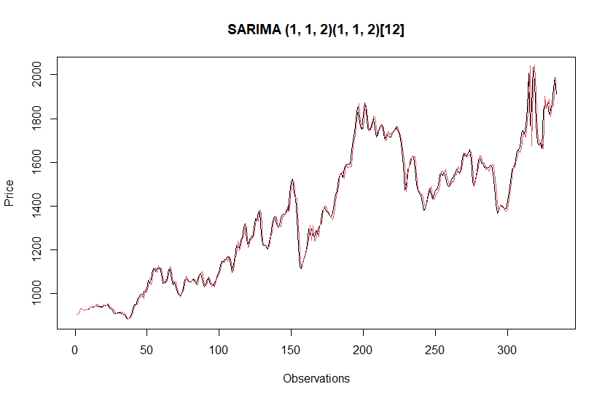
SARIMA

Slide 14


SARIMA

Slide 15

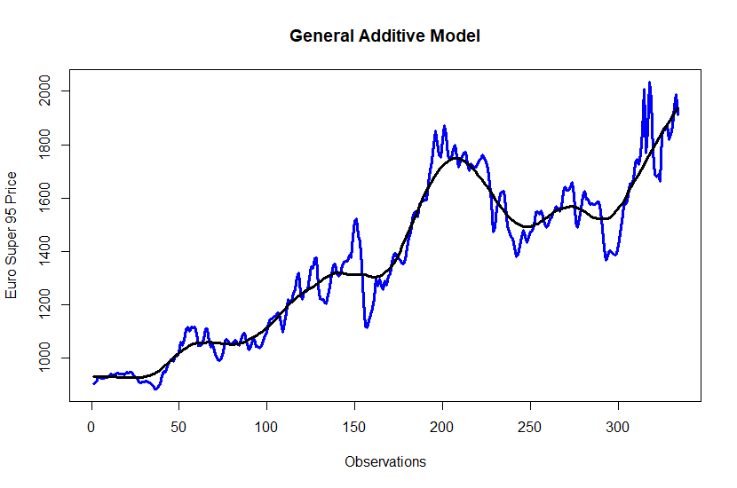
General Additive Model
price ~ lo(time, span = 0.15)
General Additive Model

Slide 16
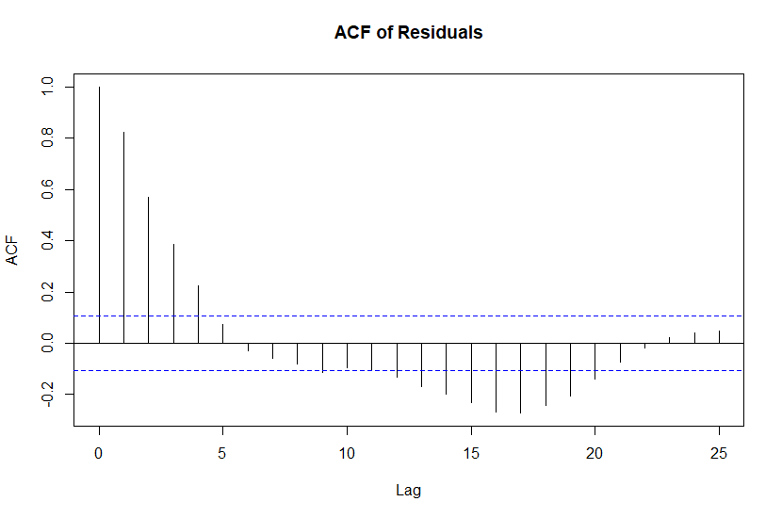
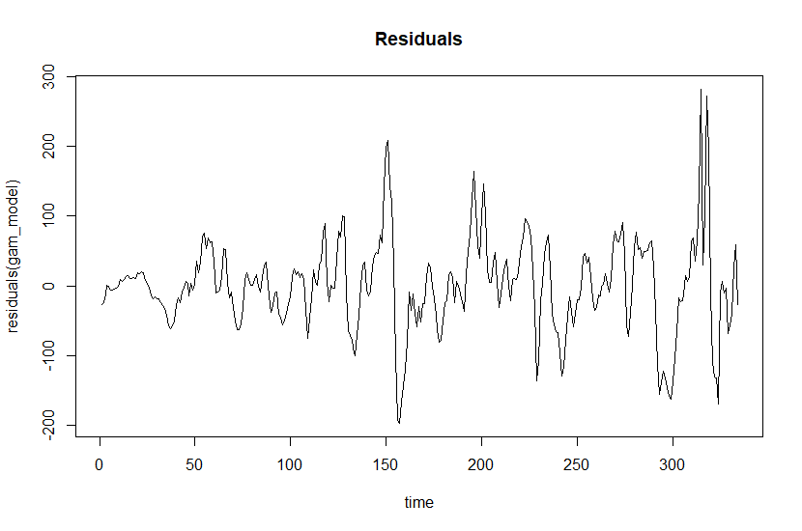
General Additive Model

Slide 17
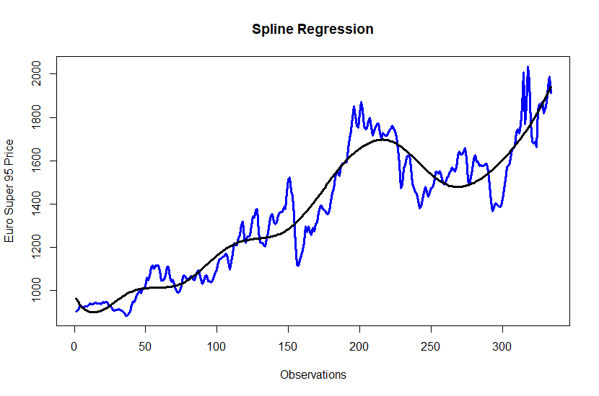

Spline Regression
R-squared: 0.9066

Slide 18
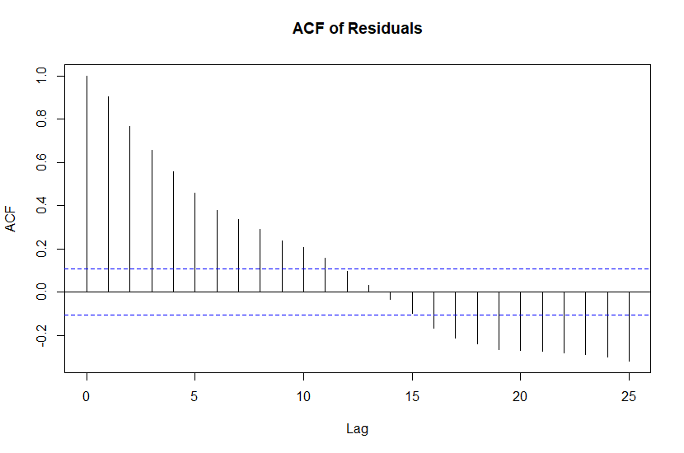
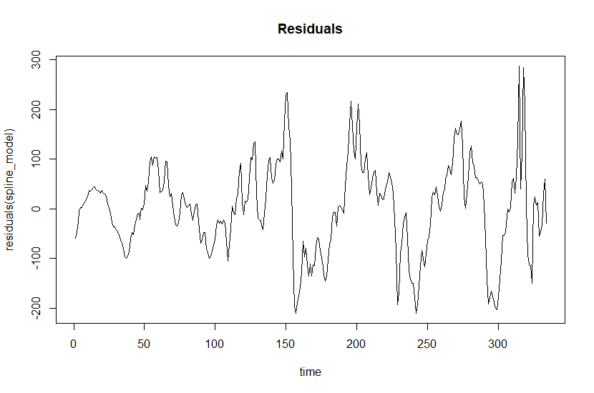
Spline Regression

Slide 19
Summary of Models for Euro Super 95
 | AIC | RMSE
TSLM | 4247.301 | 133.94
ARIMA | 3364.53 | 37.19
SARIMA | 3276.24 | 36.23
GAM | 3766.455 | 65.26
SPLINE REGRESSION | 3983.81 | 90.55

Slide 20
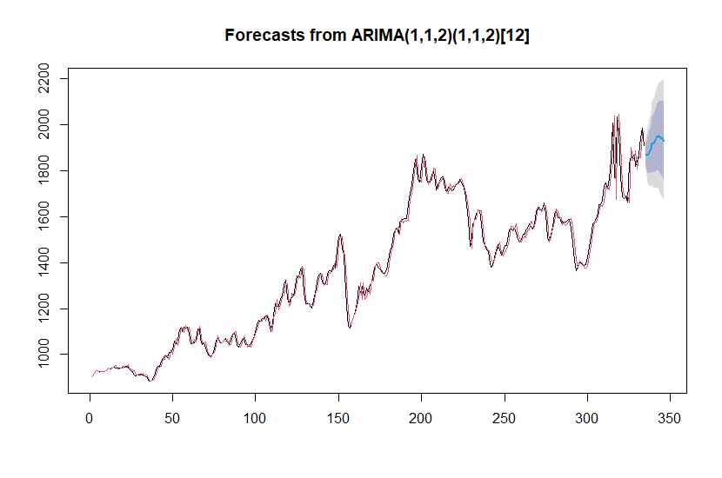
Forecast
Since SARIMA model has the best metrics, we used it for the future predictions
Now we will forecast the next 12 months with SARIMA model

Slide 21
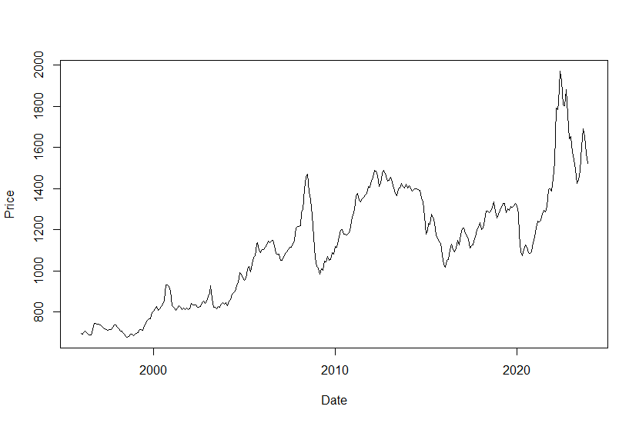
Heating Gas Oil

Slide 22
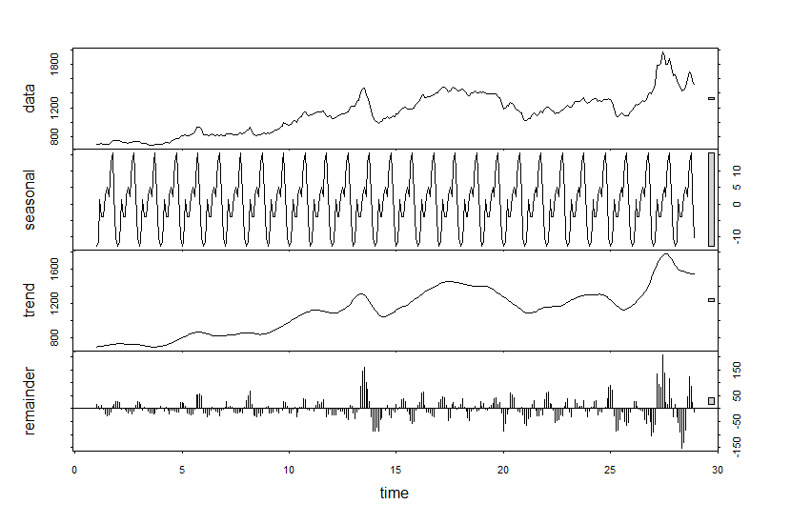

Decomposition of Heating Gas Oil

Slide 23

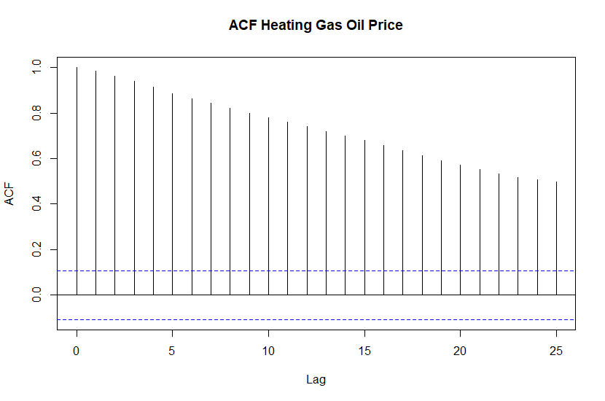
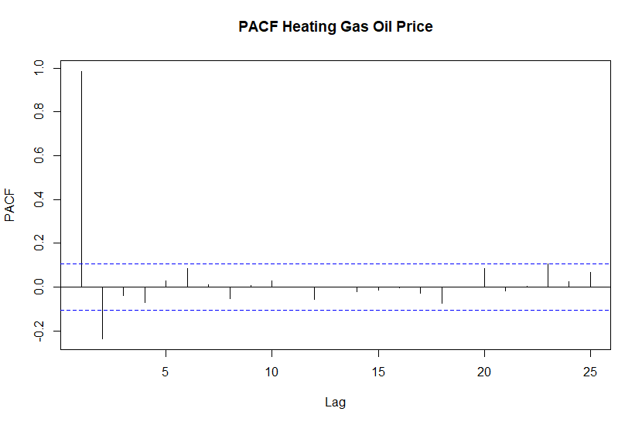
Autocorrelations

Slide 24
TSLM of Heating Gas Oil
 | Estimate | Std Error | T value | Pr(>|t|)
Intercept | 699.45223 | 32.07653 | 21.806 | <2e-16 ***
trend | 2.40417 | 0.08594 | 27.976 | <2e-16 ***
Season 2 | 1.80262 | 40.80911 | 0.044 | 0.965
Season 3 | 15.52667 | 40.80938 | 0.380 | 0.704
Season 4 | 10.58179 | 40.80984 | 0.259 | 0.796
Season 5 | 11.24262 | 40.81047 | 0.275 | 0.783
Season 6 | 17.14988 | 40.81128 | 0.420 | 0.675
Season 7 | 19.35714 | 40.81228 | 0.474 | 0.636
Season 8 | 16.14155 | 40.81346 | 0.395 | 0.693
Season 9 | 26.06238 | 40.8148 | 0.639 | 0.524
Season 10 | 28.78000 | 40.81635 | 0.705 | 0.481
Season 11 | 16.26940 | 40.81807 | 0.399 | 0.690
Season 12 | 3.17238 | 40.81997 | 0.078 | 0.938

Slide 25
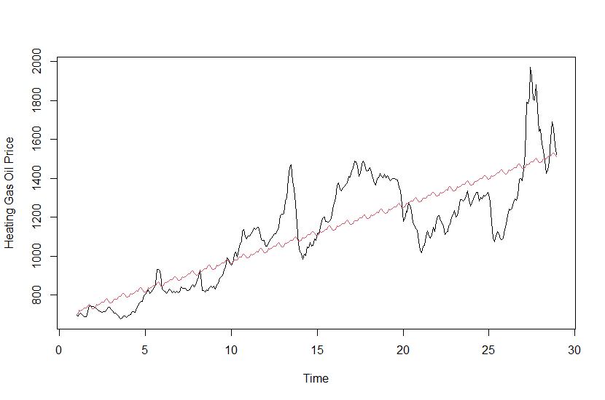
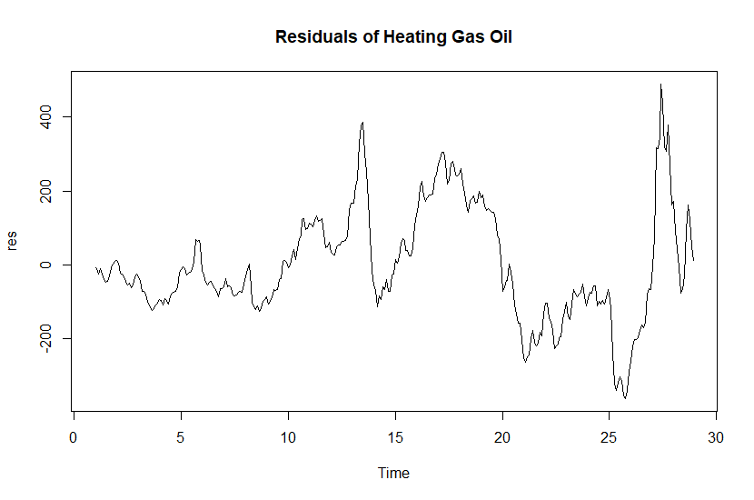

Linear Model with Trend and Seasonality
DW :0.055561
R-squared: 0.7087

Slide 26
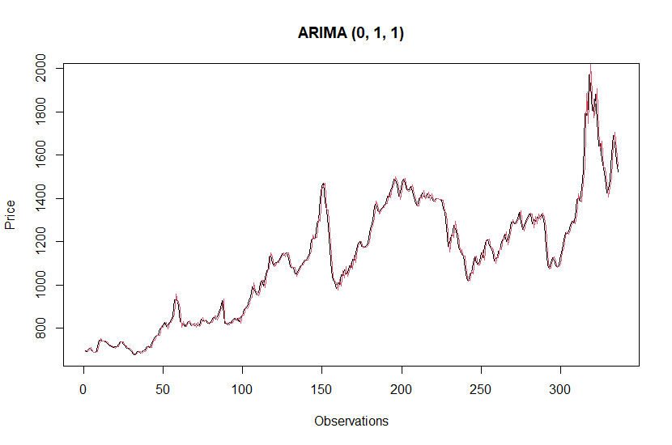

AUTO ARIMA

Slide 27

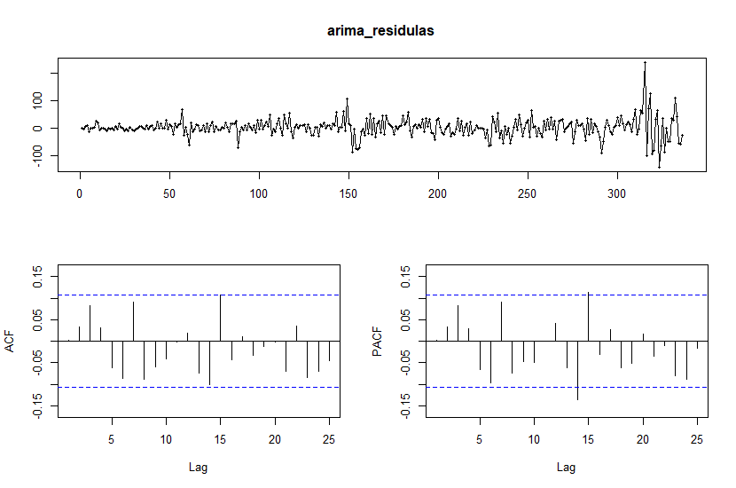
AUTO ARIMA

Slide 28

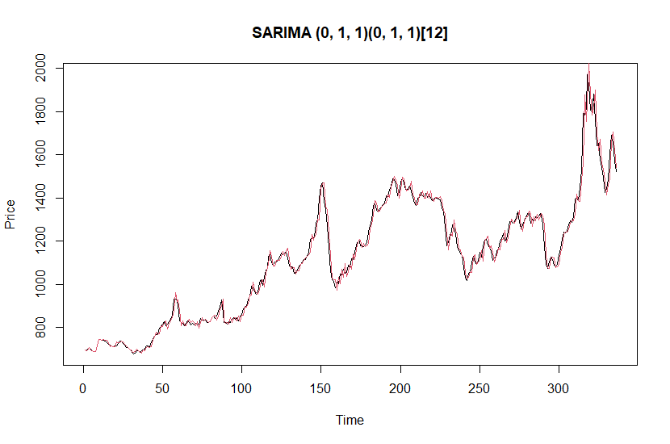
SARIMA

Slide 29
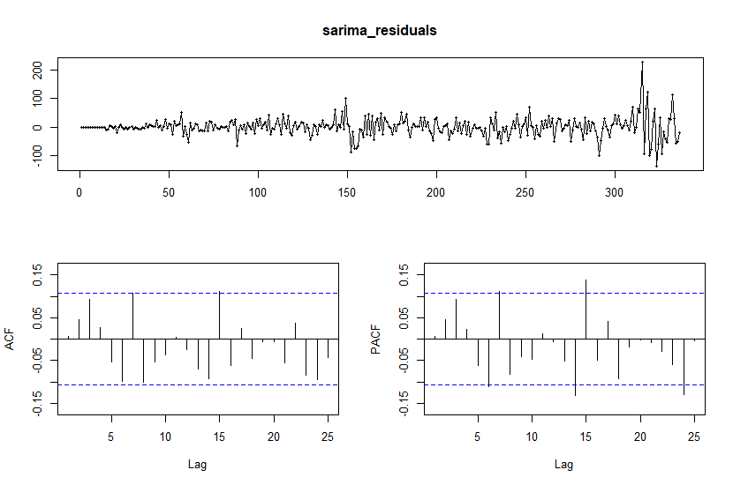

SARIMA

Slide 30
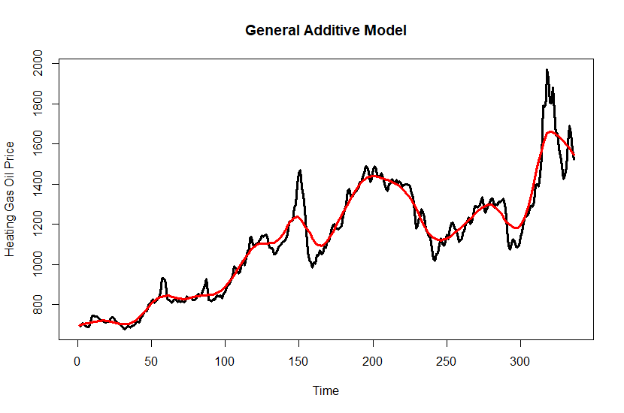

General Additive Model
price ~ lo(time, span = 0.10)

Slide 31
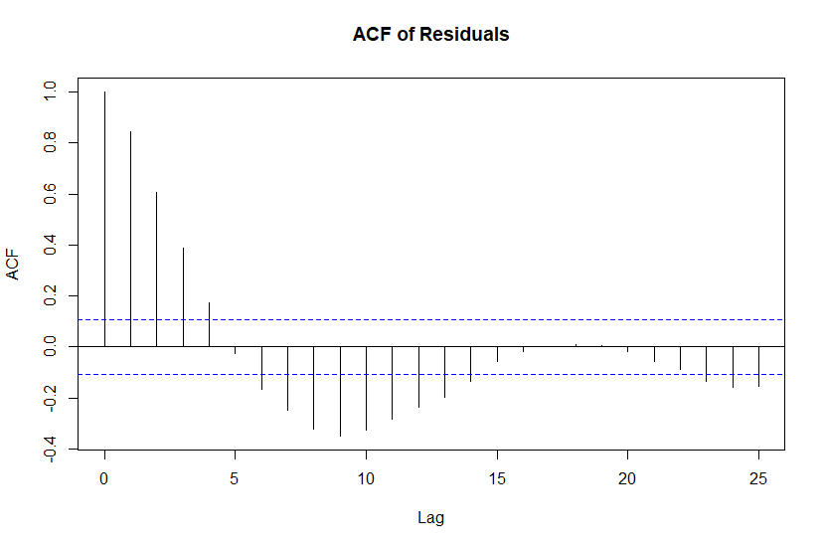
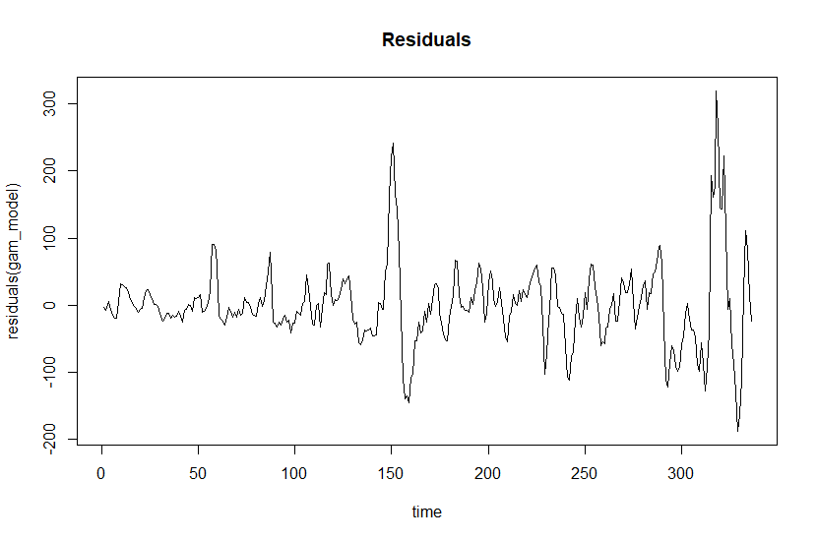
General Additive Model

Slide 32
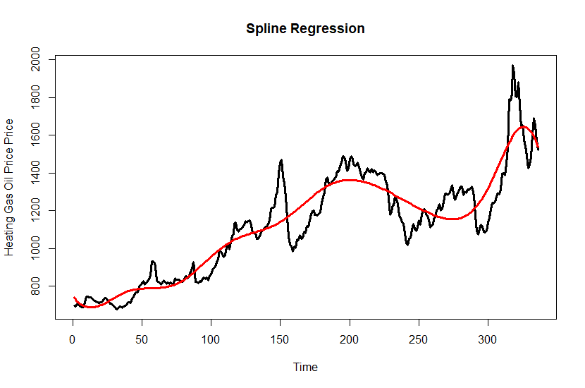

Spline Regression
R-squared: 0.8637

Slide 33
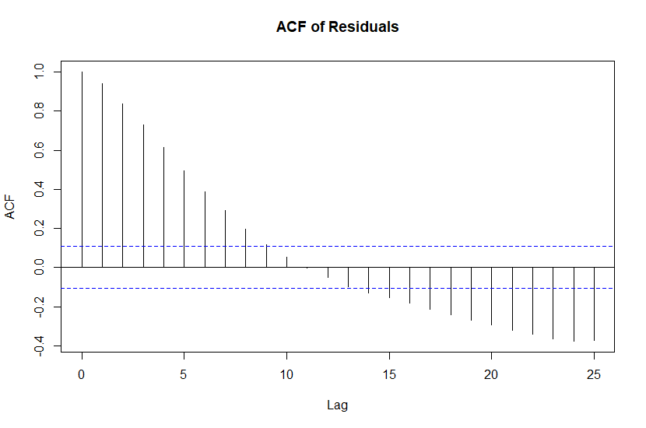
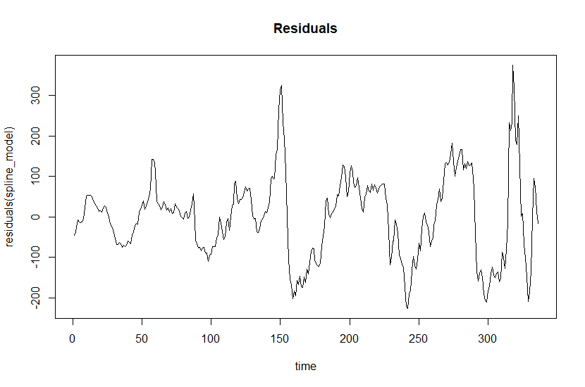
Spline Regression

Slide 34
Summary of Models for Heating Gas Oil
 | AIC | RMSE
TSLM | 4347.375 | 149.71
ARIMA | 3312.28 | 33.68
SARIMA | 3230.36 | 32.80
GAM | 3749.307 | 60.287
SPLINE REGRESSION | 4090.11 | 102.395

Slide 35
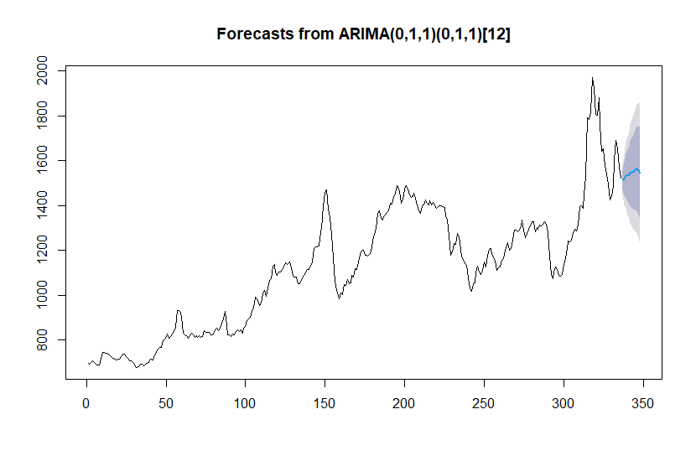
Forecast
AS you can see , The best model is SARIMA so now we will forecast for the next year with SARIMA model

Slide 36
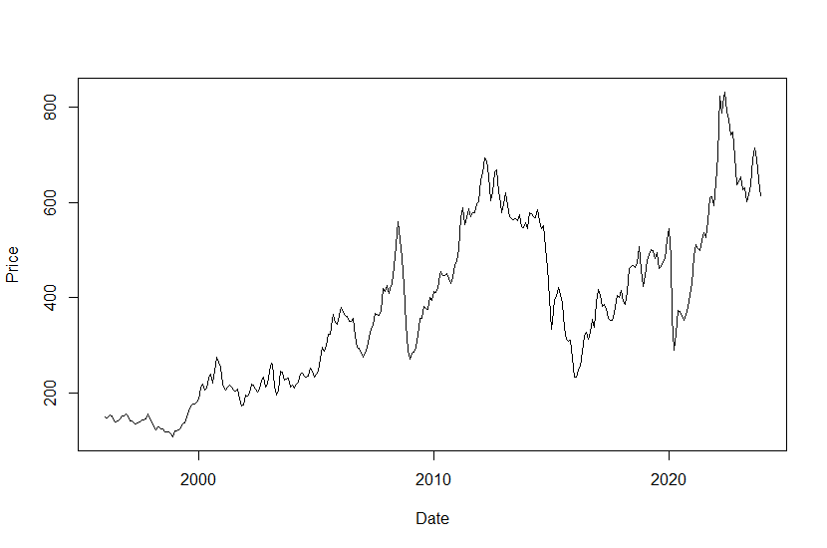
Heavy Fuel Oil

Slide 37
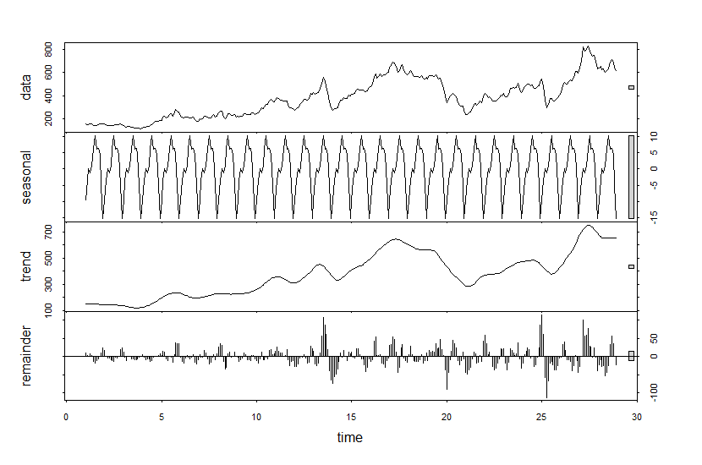
Decomposition of Heavy Fuel Oil

Slide 38
TSLM of Heavy Fuel Oil
 | Estimate | Std Error | T value | Pr(>|t|)
Intercept | 124.67133 | 21.88628 | 5.696 | 2.76e-08 ***
trend | 1.42245 | 0.05864 | 24.259 | < 2e-16 ***
Season 2 | 6.22362 | 27.84465 | 0.224 | 0.823
Season 3 | 10.34866 | 27.84483 | 0.372 | 0.710
Season 4 | 9.07549 | 27.84514 | 0.326 | 0.745
Season 5 | 11.60340 | 27.84557 | 0.417 | 0.677
Season 6 | 16.17987 | 27.84613 | 0.581 | 0.562
Season 7 | 20.12527 | 27.84681 | 0.723 | 0.470
Season 8 | 15.63389 | 27.84761 | 0.561 | 0.575
Season 9 | 15.68393 | 27.84854 | 0.563 | 0.574
Season 10 | 13.98469 | 27.84959 | 0.502 | 0.616
Season 11 | 4.57974 | 27.85076 | 0.164 | 0.869
Season 12 | -5.40700 | 27.85206 | -0.194 | 0.846

Slide 39
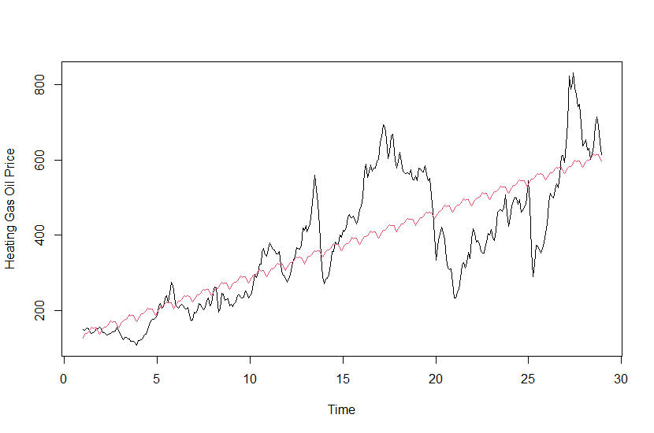
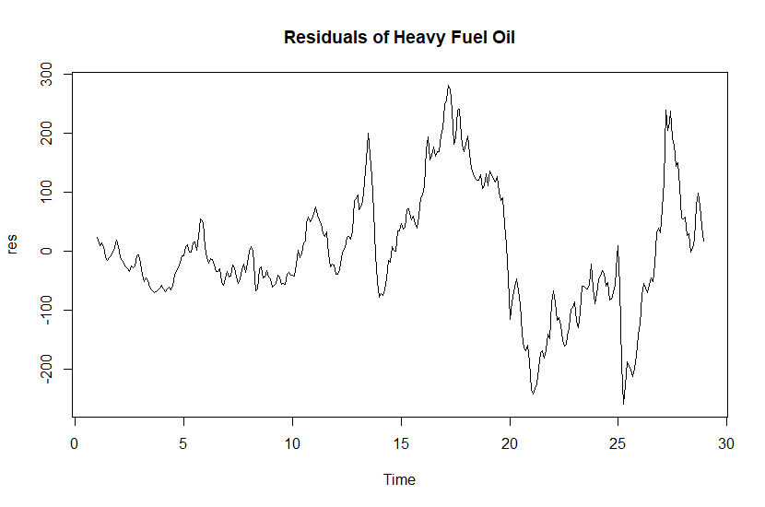
Linear Model with Trend and Seasonality
DW : 0.05576
R-squared: 0.6465

Slide 40
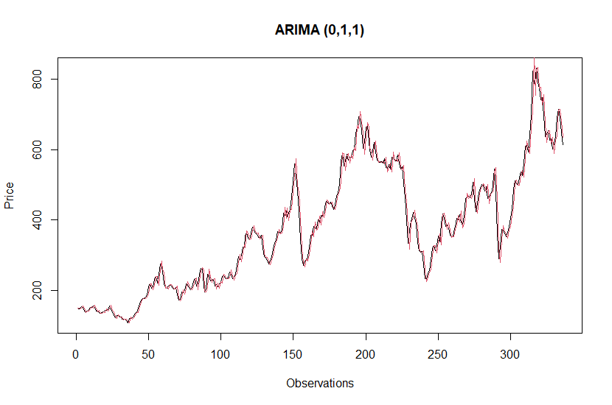

AUTO ARIMA

Slide 41

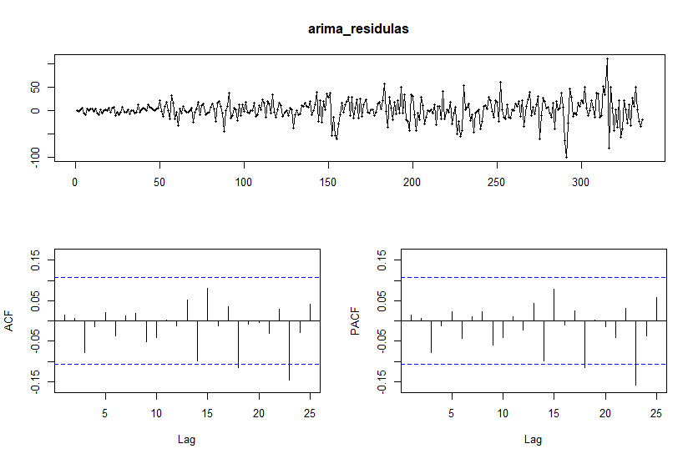
AUTO ARIMA

Slide 42
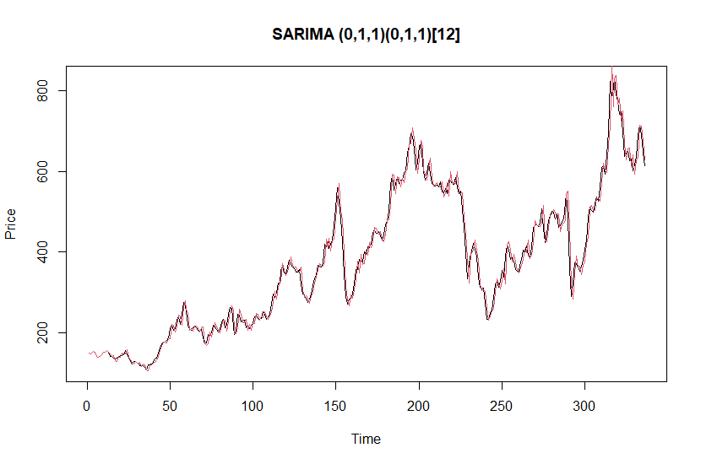

SARIMA MODEL

Slide 43
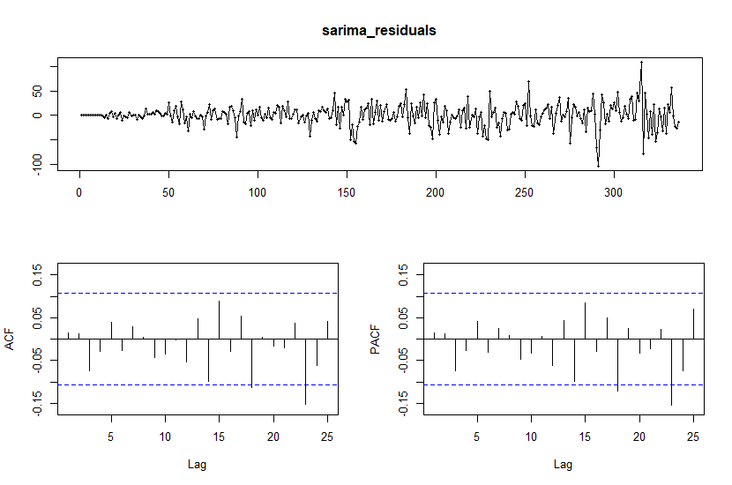

SARIMA MODEL

Slide 44

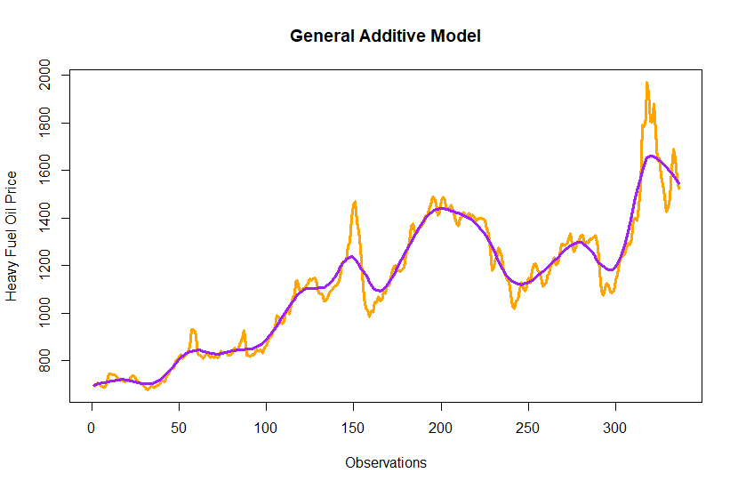
GENERAL ADDITIVE MODEL
price ~ lo(time, span = 0.10)

Slide 45
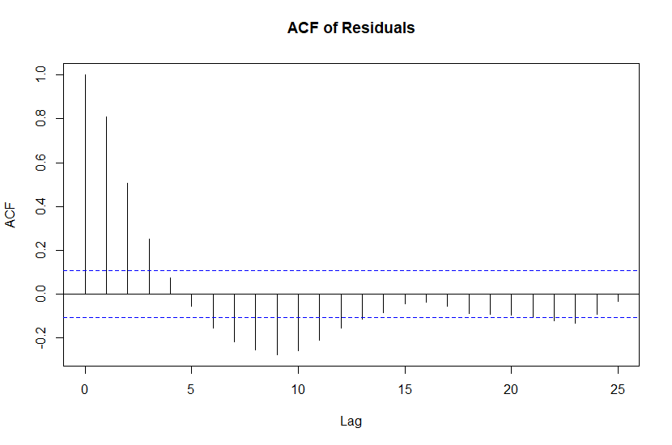
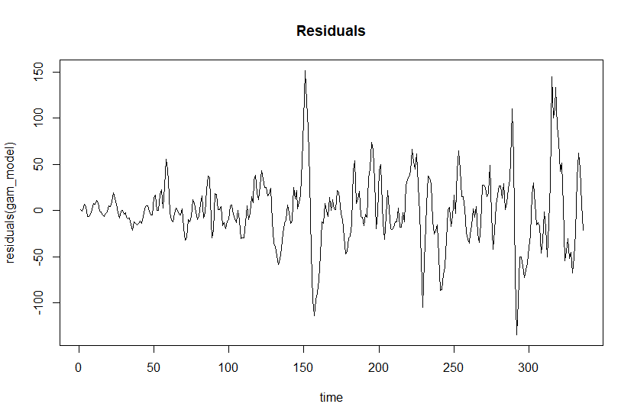
GENERAL ADDITIVE MODEL

Slide 46
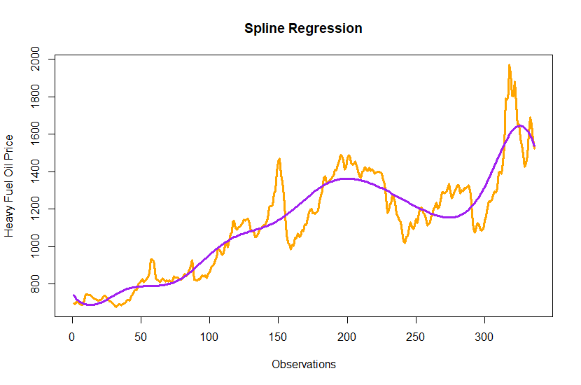
Spline Regression
R-squared: 0.8637

Slide 47
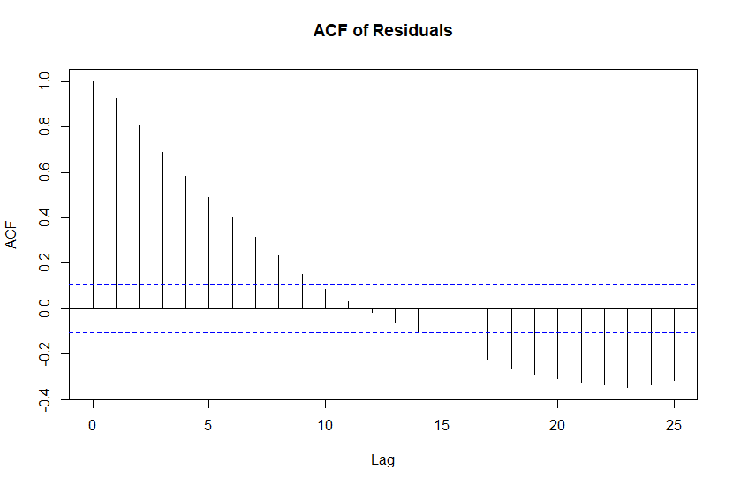

Spline Regression

Slide 48
Summary of Models for Heavy Fuel Oil
 | AIC | RMSE
TSLM | 4090.493 | 102.15
ARIMA | 3050.93 | 22.8043
SARIMA | 2980.87 | 22.293
GAM | 3436.445 | 37.8472
SPLINE REGRESSION | 3774.93 | 63.98

Slide 49


Forecast
ARIMA and SARIMA have the minimum AIC and RMSE compared to other models

Slide 50
THANK YOU!

